Slide 1
Probability
Algebra 2
Chapter 8

Slide 2
This Slideshow was developed to accompany the textbook
  Big Ideas Algebra 2
  By Larson, R., Boswell
  2022 K12 (National Geographic/Cengage)
Some examples and diagrams are taken from the textbook.
Slides created by
Richard Wright, Andrews Academy
rwright@andrews.edu

Slide 3
8.1 Sample Spaces and Probability
After this lesson…
• I can list the possible outcomes in a sample space.
• I can find theoretical probabilities.
• I can find experimental probabilities.

Slide 4
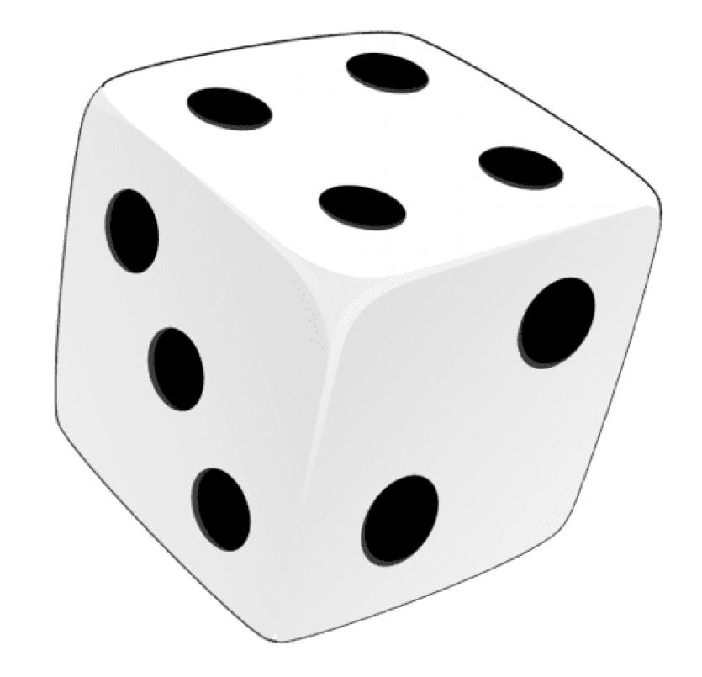
8.1 Sample Spaces and Probability
Work with a partner.
a. Describe the set of all possible outcomes for each experiment.
i. Three coins are flipped.
ii. One six-sided die is rolled.
iii. Two six-sided dice are rolled.

Slide 5
8.1 Sample Spaces and Probability
Sample Spaces
  The set of all possible outcomes in a probability experiment
  Example
    Probability Experiment: Flipping a Coin
    Sample Space: H, T
    Event (wanted outcome): H
    Outcome (what happened): T

Slide 6
8.1 Sample Spaces and Probability
408#2 Find the number of possible outcomes and then list all the possible outcomes.
You flip 4 coins
Notes:
Number of outcomes: 2·2·2·2 = 16
Make a tree diagram
Coin1: H T
Coin2: H T H T
Coin3: H T H T H T H T
Coin4: H T H T H T H T H T H T H T H T
HHHH, HHHT, HHTH, HHTT, HTHH, HTHT, HTTH, HTTT, THHH, THHT, THTH, THTT, TTHH, TTHT, TTTH, TTTT

Slide 7
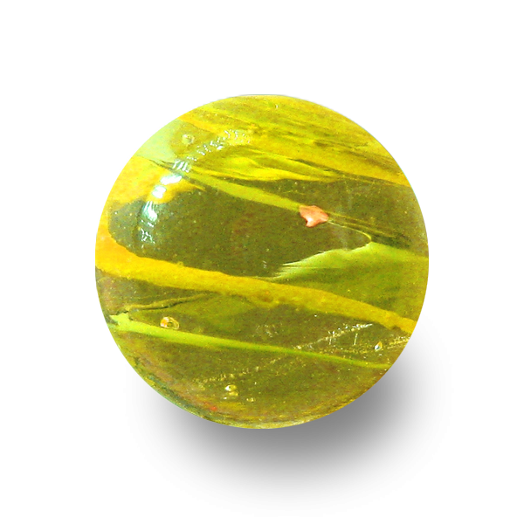
8.1 Sample Spaces and Probability
408#1 Find the number of possible outcomes and then list all the possible outcomes.
You flips a coin and draw a marble at random from a bag with 2 purple marbles and 1 white marble.
Notes:
Number of outcomes: 2·3 = 6
Make a tree diagram
Coin: H T
Marble: P P W P P W
HP, HP, HW, TP, TP, TW

Slide 8

8.1 Sample Spaces and Probability
Probability
  A number between 0 and 1 to indicate how likely something is to happen
  0 = cannot happen
  1 = always happens
Theoretical Probability
$$P\left(A\right)=\frac{\text{Number} \text{of} \text{ways} \text{A} \text{happens}}{\text{Total} \text{number} \text{of} \text{possible} \text{outcomes}}$$

Slide 9
8.1 Sample Spaces and Probability
You flip a coin four times. What is the probability that the coins shows heads exactly three times?
408#5 A game show airs 5 days a week. Each day a prize is randomly placed behind one of two doors. What is the probability that exactly two contestant guess the correct door during a week?
Notes:
Make a tree diagram
Coin1: H T
Coin2: H T H T
Coin3: H T H T H T H T
Coin4: H T H T H T H T H T H T H T H T
HHHH, HHHT, HHTH, HHTT, HTHH, HTHT, HTTH, HTTT, THHH, THHT, THTH, THTT, TTHH, TTHT, TTTH, TTTT
$$P\left(3H\right)=\frac{4}{16}=\frac{1}{4}=25\%$$
Sample Space:
Day1: W L
Day2: W L W L
Day3: W L W L W L W L
Day4: W L W L W L W L W L W L W L W L
Day5: W L W L W L W L W L W L W L W L W L W L W L W L W L W L W L W L
WWWWW, WWWWL, WWWLW, WWWLL, WWLWW, WWLWL, WWLLW, WWLLL, WLWWW, WLWWL, WLWLW, WLWLL, WLLWW, WLLWL, WLLLW, WLLLL
LWWWW, LWWWL, LWWLW, LWWLL, LWLWW, LWLWL, LWLLW, LWLLL, LLWWW, LLWWL, LLWLW, LLWLL, LLLWW, LLLWL, LLLLW, LLLLL
$$P\left(2W\right)=\frac{10}{32}=\frac{5}{16}=31.25\%$$

Slide 10
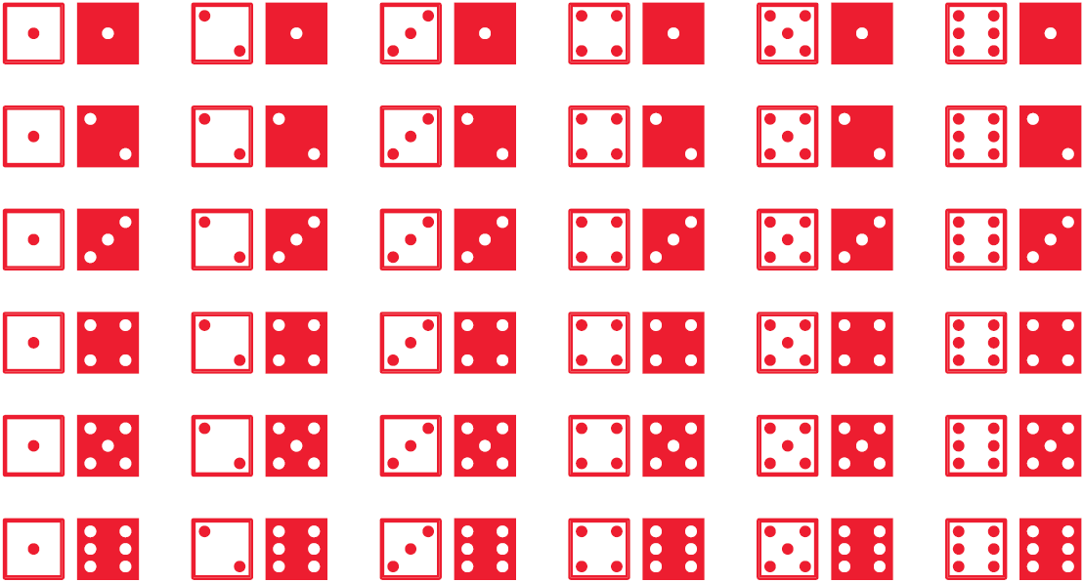
8.1 Sample Spaces and Probability
Two D6 are rolled. What is the probability of rolling a sum that is not 2?
The sum is less than or equal to 10?
Try #7 (a) not 4 (b) greater than 5
Notes:
D6 means six-sided-dice
$$P\left(\sim 2\right)=\frac{35}{36}≈0.972$$
$$P\left(n≤10\right)=\frac{33}{36}=\frac{11}{12}≈0.917$$
#7 $P\left(\sim 4\right)=\frac{33}{36}=\frac{11}{12}≈92\%;P\left(>5\right)=\frac{26}{36}=\frac{13}{18}≈72\%$

Slide 11
8.1 Sample Spaces and Probability
408#12 A student loses his earbuds while walking home form school. The earbuds are equally likely to be at any point along the path shown. What is the probability that the earbuds are on Cherry Street?
Try #11 Probability of Yellow
Notes:
$$P\left(Cherry St.\right)=\frac{Cherry Str}{Whole path}=\frac{0.2 mi}{0.1 mi+0.4 mi+0.2 mi}=\frac{0.2}{0.7}=\frac{2}{7}=28.6\%$$
$$P\left(Y\right)=\frac{Yellow area}{total area}=\frac{π9^{2}−6^{2}−2\left(\frac{1}{2}6·6\right)}{{18}^{2}}=\frac{182.5}{324}≈56.3\%$$

Slide 12
8.1 Sample Spaces and Probability
Experimental Probability
  Probability based on the results of an experiment
Each section of the spinner shown has the same area. The spinner is spun 50 times. The table shows the results. For which color is the experimental probability of stopping on the color the same as the theoretical probability?
Try 409#13
408 #1, 2, 3, 5, 7, 8, 9, 11, 12, 13, 15, 17, 19, 23, 25, 29, 33, 35, 37, 39
Notes:
Theoretical Probability: 1/5
Experimental Probability:
Red: 5/50=1/10
Green: 20/50=2/5
Blue: 3/50
Yellow: 10/50=1/5
Purple: 12/50=6/25
Yellow is the same theoretical and experimental
#13 Theoretical Probability for each color = 1/5=20%
Experimental
White: $\frac{5}{30}=\frac{1}{6}≈16.7\%$
Black: $\frac{6}{30}=\frac{1}{5}=20\%$
Red: $\frac{8}{30}=\frac{4}{15}≈26.7\%$
Green: $\frac{2}{30}=\frac{1}{15}≈6.7\%$
Blue: $\frac{9}{30}=\frac{3}{10}=30\%$
Blue is higher

Slide 13
8.2 Two-Way Tables and Probability
After this lesson…
• I can make two-way tables.
• I can find and interpret relative frequencies and conditional relative frequencies.
• I can use conditional relative frequencies to find probabilities.

Slide 14
8.2 Two-Way Tables and Probability
Work with a partner. A survey of 80 students at a high school asks whether they participate in outside of school activities and whether they participate in inside of school activities. The results are shown in the Venn diagram.
a. Show how you can represent the data in the Venn diagram using a single table.

Slide 15
8.2 Two-Way Tables and Probability
Two-Way Table
  Displays data from one source that belongs to two different categories
  Entries are joint frequencies
  Totals are marginal frequencies

Slide 16
8.2 Two-Way Tables and Probability
There are 16 juniors and 24 seniors on a debate team. Of those, 7 juniors and 19 seniors qualify for a state debate competition. Organize this information in a two-way table. Then find and interpret the marginal frequencies.
Try 415#3
 |  | State Competition
 |  | Qualified | Not Qualified | Total
Class | Jr.
 | Sr.
 | Total
Notes:
7 9 16
19 5 24
26 14 40
40 students are on the debate team, 26 students qualified, 14 students did not qualify, 16 juniors qualified, and 24 seniors qualified.
#3 M F Total
Y 132 151 283
N 39 29 68
Total 171 180 351
351 people were surveyed, 171 males were surveyed, 180 females were surveyed, 283 people said yes, 68 people said no.

Slide 17
8.2 Two-Way Tables and Probability
Relative Frequencies
  Joint Relative Frequency
    Ratio of joint frequency to total values
  Marginal Relative Frequency
    Sum of joint relative frequencies in a row or column

Slide 18
8.2 Two-Way Tables and Probability
Make a table showing the relative frequencies.
 |  | State Competition
 |  | Qualified | Not Qualified | Total
Class | Jr.
 | Sr.
 | Total
 |  | State Competition
 |  | Qualified | Not Qualified | Total
Class | Jr. | 7 | 9 | 16
 | Sr. | 19 | 5 | 24
 | Total | 26 | 14 | 40
Try 415#5
Notes:
$\frac{7}{40}=0.175$ $\frac{9}{40}=0.225$ $\frac{16}{40}=0.4$
$\frac{19}{40}=0.475$ $\frac{5}{40}=0.125$ $\frac{24}{40}=0.6$
$\frac{26}{40}=0.65$ $\frac{14}{40}=0.35$ $\frac{40}{40}=1$
The joint relative frequency 0.475 means that 47.5% of the students on the debate team are seniors who qualify for the state debate competition. So, the probability that a randomly selected student from the debate team is a senior that qualified for the state debate competition is 47.5%.
The marginal relative frequency 0.4 means that 40% of the students on the debate team are juniors. So, the probability that a randomly selected student from the debate team is a junior is 40%.
#5 M F Total
Y 0.376 0.430 0.806
N 0.111 0.083 0.194
Total 0.487 0.513 1

Slide 19
8.2 Two-Way Tables and Probability
Conditional Relative Frequencies
  Ratio of a joint relative frequency to the marginal relative frequency
  Can be done for row totals or column totals

Slide 20
8.2 Two-Way Tables and Probability
Make a two-way table that shows the conditional relative frequencies based on (a) the row totals
Try 415#7
415 #1, 2, 3, 5, 7, 9, 11, 13, 14, 15, 19, 21, 25, 27, 29
 |  | State Competition
 |  | Qualified | Not Qualified | Total
Class | Jr. | 7 | 9 | 16
 | Sr. | 19 | 5 | 24
 | Total | 26 | 14 | 40
 |  | State Competition
 |  | Qualified | Not Qualified
Class | Jr.
 | Sr.
Notes:
$\frac{7}{16}=0.438$ $\frac{9}{16}=0.563$
$\frac{19}{24}=0.792$ $\frac{5}{24}=0.208$
The conditional relative frequency 0.792 means that about 79.2% of the seniors on the debate team qualified for the state debate competition. So, the probability that a randomly selected senior from the debate team qualified for the state debate competition is about 79.2%.
#7a Y N #7b Y N
Y 0.534 0.483 Y 0.481 0.519
N 0.466 0.517 N 0.431 0.569

Slide 21
8.3 Conditional Probability
After this lesson…
• I can explain the meaning of conditional probability.
• I can fi nd conditional probabilities.
• I can make decisions using probabilities.

Slide 22
8.3 Conditional Probability
Work with a partner. Six pieces of paper, numbered 1 through 6, are placed in a bag. You draw two pieces of paper one at a time without replacing the first.
b. What is the probability that you draw two odd numbers?
c. When the first number you draw is odd, what is the probability that the second number you draw is also odd? Explain.
d. Compare and contrast the questions in parts (b) and (c).
Notes:
b. $\frac{6}{30}=\frac{1}{5}=20\%$ (1-3, 1-5, 3-1, 3-5, 5-1, 5-3) total 6·5=30
c. $\frac{2}{5}= 40\%$ (two or five remaining numbers are odd)

Slide 23

8.3 Conditional Probability
Conditional Probability
  Probability that B occurs given that A has already occurred
  $P\left(B | A\right)$

Slide 24
8.3 Conditional Probability
A family has three rabbits and two guinea pig. They randomly select a pet to get brushed and then randomly select a different pet to get a treat. Find the probability that they select a rabbit to get a treat given that they selected the guinea pig to get brushed.
Try 422#1
Notes:
Sample Space:
R1, R2 R2, R1 R3, R1 G1, R1 G2, R1
R1, R3 R2, R3 R3, R2 G1, R2 G2, R2
R1, G1 R2, G1 R3, G1 G1, R3 G2, R3
R1, G2 R2, G2 R3, G2 G1, G2 G2, G1
$$P\left(R | G\right)=\frac{6}{8}=\frac{3}{4}=0.75$$
#1 $\frac{2 veg}{4 options}=50\%$

Slide 25
8.3 Conditional Probability
A quality-control inspector checks for defective parts. The two-way table shows the results. Find each probability.
P(pass | defective)
P(pass | non-defective)
Try 422#3
Notes:
$$P\left(pass | defective\right)=\frac{5}{5+24}=\frac{5}{29}$$
$$P\left(pass | nondefective\right)=\frac{208}{208+9}=\frac{208}{217}$$
#3 $P(pass | Test A)=\frac{49}{49+7}87.5=\%; P(Test C \left| fail\right)=\frac{12}{7+6+12}=48\%$

Slide 26

8.3 Conditional Probability
Conditional Probability Formula
  $P\left(B | A\right)=\frac{P\left(A and B\right)}{P\left(A\right)}$
Find P(pass | non-defective) using the formula for conditional probability.
    Try 422#5
Notes:
$$P\left(B | A\right)=\frac{P\left(A and B\right)}{P\left(A\right)}$$
$$P\left(pass | nondefective\right)=\frac{\frac{208}{246}}{\frac{208+9}{246}}=\frac{0.846}{0.882}=0.959$$
#5 $P\left(pass \right| Test A)=\frac{P\left(pass and Test A\right)}{P\left(Test A\right)}=\frac{\frac{49}{154}}{\frac{56}{154}}=87.5\%$

Slide 27
8.3 Conditional Probability
At a clothing store, 75% of customers buy a pair of pants, 24% of customers buy a belt, and 20% of customers buy a pair of pants and a belt.
What is the probability that a customer who buys a pair of pants also buys a belt?
What is the probability that a customer who buys a belt also buys a pair of pants?
Try 422#9
Notes:
$$P\left(belt | pants\right)=\frac{P\left(belt and pants\right)}{P\left(pants\right)}=\frac{0.20}{0.75}=0.267$$
$$P\left(pants | belt\right)=\frac{P\left(pants and belt\right)}{P\left(belt\right)}=\frac{0.20}{0.24}=0.833$$
#9 $P\left(Dance \right| Game)=\frac{P\left(dance and game\right)}{P\left(game\right)}=\frac{0.23}{0.43}=53.5\%$; $P\left(Game \right| Dance)=\frac{P\left(game and dance\right)}{P\left(dance\right)}=\frac{0.23}{0.48}=47.9\%$

Slide 28
8.3 Conditional Probability
An airline company strives to not lose luggage. A manager is evaluating three flights in order to determine which flight loses luggage the least often. At the end of each day, the manager records whether or not luggage was lost on the flights that day. The table shows the results. Which flight loses luggage the least often?
Try 423#11
422 #1, 3, 5, 7, 9, 10, 11, 13, 15, 16, 17, 18, 19, 21, 25, 29, 31, 33, 35, 37
Notes:
Make two-way table with shows the joint and marginal relative frequencies (40 marks)
Lost Not Lost Total
Flight A 0.250 0.075 0.325
Flight B 0.225 0.125 0.350
Flight C 0.300 0.025 0.325
Total 0.775 0.225 1
$$P\left(\sim lost | A\right)=\frac{P\left(A and \sim lost\right)}{P\left(A\right)}=\frac{0.075}{0.325}=0.231$$
$$P\left(\sim lost | B\right)=\frac{P\left(B and \sim lost\right)}{P\left(B\right)}=\frac{0.125}{0.350}=0.357$$
$$P\left(\sim lost | C\right)=\frac{P\left(C and \sim lost\right)}{P\left(C\right)}=\frac{0.025}{0.325}=0.077$$
Flight B has highest probability of not losing luggage.
#11
$$P\left(late | A\right)=\frac{P\left(late and A\right)}{P\left(A\right)}=\frac{\frac{4}{41}}{\frac{11}{41}}=\frac{4}{11}=36.4\%$$
$$P\left(late | B\right)=\frac{P\left(late and B\right)}{P\left(B\right)}=\frac{3}{14}=21.4\%$$
$$P\left(late | C\right)=\frac{P\left(late and C\right)}{P\left(C\right)}=\frac{4}{16}=25\%$$
Choose route B

Slide 29
8.4 Independent and Dependent Events
After this lesson…
• I can explain how independent events and dependent events are different.
• I can determine whether events are independent.
• I can find probabilities of independent and dependent events.

Slide 30

8.4 Independent and Dependent Events
2 events → 2 outcomes
Independent Events
  One event does not affect the other event
  $P\left(A and B\right)=P\left(A\right)·P(B)$
  $P\left(A | B\right)=P\left(A\right)$ and $P\left(B | A\right)=P(B)$
Dependent Events
  One event does affect the other event
    $P\left(A and B\right)=P\left(A\right)·P\left(B | A\right)$

Slide 31
8.4 Independent and Dependent Events
A bag contains six pieces of paper, numbered 1 through 6. You randomly select a piece of paper, replace it, and then randomly select another piece of paper. Use a sample space to determine whether randomly selecting a 5 first and randomly selecting an odd number second are independent events.
Notes:
Independent because there are 6 choices both times you draw

Slide 32
8.4 Independent and Dependent Events
A bag contains six pieces of paper, numbered 1 through 6. You randomly select a piece of paper, set it aside, and then randomly select another piece of paper. Use a sample space to determine whether randomly selecting an even number first and randomly selecting a 4 second are independent events.
Try 430#1, 5
Notes:
Dependent because there are 6 choices the first time, but only 5 choices the second time. One of the choices has been removed
#1: Independent – The spinner has same probability with each spin
#5: Dependent – The number of choices changes after the first draw

Slide 33
8.4 Independent and Dependent Events
A store surveys customers of different ages. The survey asks whether they want to see the store expand its toy department. The results, given as joint relative frequencies, are shown in the two-way table. Determine whether wanting to see the store expand and being less than 10 years old are independent events.
Try 430#11
Notes:
not independent;
$$P\left(<10\right)=0.27+0.09=0.36$$
$$P\left(<10 \right| Yes)=\frac{P\left(<10 and Yes\right)}{P\left(Yes\right)}=\frac{0.27}{0.27+0.06+0.23}=0.48$$
P(less than 10 years old) ≠ P(less than 10 years old | yes)
#11: P(Yes) = 0.75; P(Yes | Saratoga) = $\frac{P\left(yes and Saratoga\right)}{P\left(Saratoga\right)}=\frac{0.289}{0.289+0.095}=0.75$
Independent because P(Yes) = P(Yes | Saratoga)

Slide 34
8.4 Independent and Dependent Events
Find the probability that you get an even number on your first spin and a number less than 3 on your second spin.
Try 431#13
Notes:
Independent
$$P\left(Even and<3\right)=P\left(even\right)·P\left(<3\right)$$
$$=\frac{4}{8}·\frac{2}{8}$$
$$=\frac{1}{2}·\frac{1}{4}$$
$$=\frac{1}{8}=0.125$$
#13: P(>500 and BR) = P(>500)P(BR) = $\frac{8}{24}·\frac{2}{24}=\frac{1}{36}≈0.028=2.8\%$

Slide 35
8.4 Independent and Dependent Events
Nine women and six men are on a committee. One person is randomly selected to be the chairperson and a different person is randomly selected to be the treasurer. Find the probability that both events A and B will occur.
Event A: The chairperson is a man.
Event B: The treasurer is a woman.
  Try 431#15
    430 #1, 3, 5, 7, 9, 11, 13, 15, 17, 19, 21, 23, 25, 27, 29, 31, 33, 35, 37, 41
Notes:
Dependent
$$P\left(M and W\right)=P\left(M\right)·P\left(W | M\right)$$
$$=\frac{6}{15}·\frac{9}{14}=0.257$$
#15: $P\left(concert and concert\right)=P\left(concert\right)P\left(concert \right| concert)=\frac{8}{20}·\frac{7}{19}=\frac{14}{95}≈0.147=14.7\%$

Slide 36
8.5 Probability of Disjoint and Overlapping Events
After this lesson…
• I can explain how disjoint events and overlapping events are different.
• I can find probabilities of disjoint events.
• I can find probabilities of overlapping events.
• I can solve real-life problems using more than one probability rule.

Slide 37
8.5 Probability of Disjoint and Overlapping Events
Compound Event
  1 event with 2 acceptable outcomes
There may be some intersections where one condition satisfies both events so the events are overlapping
If there is no intersection, then they are disjoint or mutually exclusive

Slide 38

8.5 Probability of Disjoint and Overlapping Events
$P\left(A or B\right)=P\left(A\right)+P\left(B\right)−P\left(A and B\right)$
If they are disjoint or mutually exclusive
  $P\left(A and B\right)=0$
A
B
Notes:
The overlap (A and B) is counted twice (once with A and once with B) so it is subtracted once.

Slide 39
8.5 Probability of Disjoint and Overlapping Events
One D6 is rolled. What is the probability of rolling a multiple of 3 or 5?
Two D6 are rolled. What is the probability of rolling a sum that is a multiple of 2 or 3?
Try 437#5
Notes:
D6 means six-sided-dice
P(mult 3 or 5) = P(mult 3) + P(mult 5) – P(mult 3 and 5)
P(mult 3 or 5) = 2/6 + 1/6 – 0 = 3/6 = ½
P(mult 2 or 3) = P(mult 2) + P(mult 3) – P(mult 2 and 3)
P(mult 2 or 3) = 3/6 + 2/6 – 1/6 = 4/6 = 2/3
#5: $P\left(R or odd\right)=P\left(R\right)+P\left(odd\right)−P\left(R and odd\right)=\frac{4}{12}+\frac{6}{12}−\frac{2}{12}=\frac{8}{12}=\frac{2}{3}≈0.667=66.7\%$

Slide 40
8.5 Probability of Disjoint and Overlapping Events
A bag contains twenty cards, numbered 1 through 20. A card is randomly selected. What is the probability that the number is a multiple of 3 or a multiple of 4?
Try #13
Notes:
$$P\left(×3 or×4\right)=P\left(×3\right)+P\left(×4\right)−P\left(×3 and×4\right)$$
$$=\frac{6}{20}+\frac{5}{20}−\frac{1}{20}$$
$$=\frac{1}{2}=0.5$$
#13: $P\left(D or I\right)=P\left(D\right)+P\left(I\right)−P\left(D and I\right)→\frac{34}{40}=\frac{18}{40}+\frac{20}{40}−P\left(D and I\right)→−\frac{4}{40}=−P\left(D and I\right)→P\left(D and I\right)=\frac{1}{10}=0.1=10\%$

Slide 41
8.5 Probability of Disjoint and Overlapping Events
Out of 45 customers at a breakfast café, 42 customers bought either coffee or orange juice. There were 30 customers who bought orange juice and 40 customers who bought coffee. What is the probability that a randomly selected customer bought both coffee and orange juice?
Notes:
$$P\left(C or O\right)=P\left(C\right)+P\left(O\right)−P\left(C and O\right)$$
$$\frac{42}{45}=\frac{40}{45}+\frac{30}{45}−P\left(C and O\right)$$
$$P\left(C and O\right)=\frac{28}{45}=0.622$$

Slide 42
8.5 Probability of Disjoint and Overlapping Events
A medical association estimates that 10.9% of the people in the United States have a thyroid disorder. A medical lab develops a simple diagnostic test for the disorder that is 96% accurate for people who have the disorder and 99% accurate for people who do not have it. The medical lab gives the test to a randomly selected person. What is the probability that the diagnosis is correct?
  Try 437#15
      437 #1-30 odd
Notes:
Tree diagram
people
/ \
0.109 0.891
with without
/ \ / \
0.96 0.04 0.99 0.01
Accurate Not Accurate Not
$$P\left(accurate\right)=P\left((with and accurate\right) or (without and accurate))$$
$$=P\left(with and accurate\right)+P\left(without and accurate\right)$$
$$=P\left(with\right)P\left(accurate | with\right)+P\left(without\right)P\left(accurate | without\right)$$
$$=0.109·0.96+0.891·0.99$$
$$=0.987$$
#15: $P\left(buy\right)=P\left(\left(M and buy\right) or \left(F and buy\right)\right)=P\left(M and buy\right)+P\left(F and buy\right)=P\left(M\right)P\left(buy | M\right)+P\left(F\right)P\left(buy | F\right)=\left(0.47\right)\left(0.40\right)+\left(0.53\right)\left(0.54\right)=0.4742=47.42\%$

Slide 43
8.6A Permutations and Combinations
After this lesson…
• I can explain the difference between permutations and combinations.
• I can find numbers of permutations and combinations.
• I can find probabilities using permutations and combinations.

Slide 44
8.6A Permutations and Combinations
Work with a partner.
a. A fair conducts three obstacle course races. In how many different orders can the dogs finish in each race? Justify your answers.
b. For each race in part (a), in how many different ways can the dogs finish first and second? Justify your answers.
c. For each race in part (a), how many different pairs of dogs can you form?
d. Explain why your answers in part (c) are different from your answers in part (b).
Notes:
Race 1: 2 orders; Race 2: 6 orders; Race 3: 24 orders
Race 1: 2 orders; Race 2: 6 orders; Race 3: 12 orders
Race 1: 1 pair; Race 2: 3 pairs; Race 3: 6 pairs
Parts a and b have order, part c does not have order

Slide 45

8.6A Permutations and Combinations
Permutation
  How many ways to order objects
    A, B, C →
    ABC, ACB, BAC, BCA, CAB, CBA → 6 ways
Number of Permutations of n objects taken r at a time
$${{}_{n}^{}P}_{r}=\frac{n!}{\left(n−r\right)!}$$
Factorial (!) – that number times all whole numbers less than it
  $5!=5⋅4⋅3⋅2⋅1=120$

Slide 46

8.6A Permutations and Combinations
Permutations on a Calculator
TI
  Enter value of n
  Press MATH → PRB $↓$ nPr
  Enter value of r
NumWorks
  Press Toolbox button
  Down to Probability
  Down to Combinatorics
  Permute(n,k)
  Enter n then r
445#7
Evaluate ₅P₂
Try 445#9
Evaluate ₉P₁
Notes:
Use the calculator
$${{}_{5}^{}P}_{2}=20$$
$${{}_{9}^{}P}_{1}=9$$

Slide 47
8.6A Permutations and Combinations
Consider the letters in the word PENCILS.
In how many ways can you arrange all of the letters?
In how many ways can you arrange 3 of the letters?
Try 445#3 ROCK
Notes:
Order = permutation
$${{}_{7}^{}P}_{7}=5040$$
$${{}_{7}^{}P}_{3}=210$$
#3
$${{}_{4}^{}P}_{4}=24$$
$${{}_{4}^{}P}_{2}=12$$

Slide 48
8.6A Permutations and Combinations
Eight people serve on a committee. In how many different ways can a chairperson, a recorder, and a treasurer be chosen from the committee members?
Try 445#13
Eleven students are competing in a graphic design contest. In how many different ways can the students finish first, second, and third?
Notes:
Order = permutation
$${{}_{8}^{}P}_{3}=336$$
#13
$${{}_{11}^{}P}_{3}=990$$

Slide 49
8.6A Permutations and Combinations
You and your friend are auditioning for a part in the school play. There are 15 people auditioning, and the order of their auditions is chosen at random. Find the probability that your audition is last and your friend’s audition is second to last.
Try 442#15
You and your friend are 2 of 8 servers working a shift in a restaurant. At the beginning of the shift, the manager randomly assigns one section to each server. Find the probability that you are assigned Section 1 and your friend is assigned Section 2
Notes:
$$P\left(last 2\right)=\frac{{{}_{2}^{}P}_{2}}{{{}_{15}^{}P}_{2}}=\frac{1}{210}≈0.00476$$
#15
$$P\left(2 sections\right)=\frac{{{}_{2}^{}P}_{2}}{{{}_{8}^{}P}_{2}}=\frac{1}{56}≈0.018$$

Slide 50

8.6A Permutations and Combinations
Combination
  Arranging of objects without order
$${{}_{n}^{}C}_{r}=\frac{n!}{\left(n−r\right)!r!}$$
Permutation have order
Combination do not have order
Notes:
Permutations had order, Combinations are without order

Slide 51
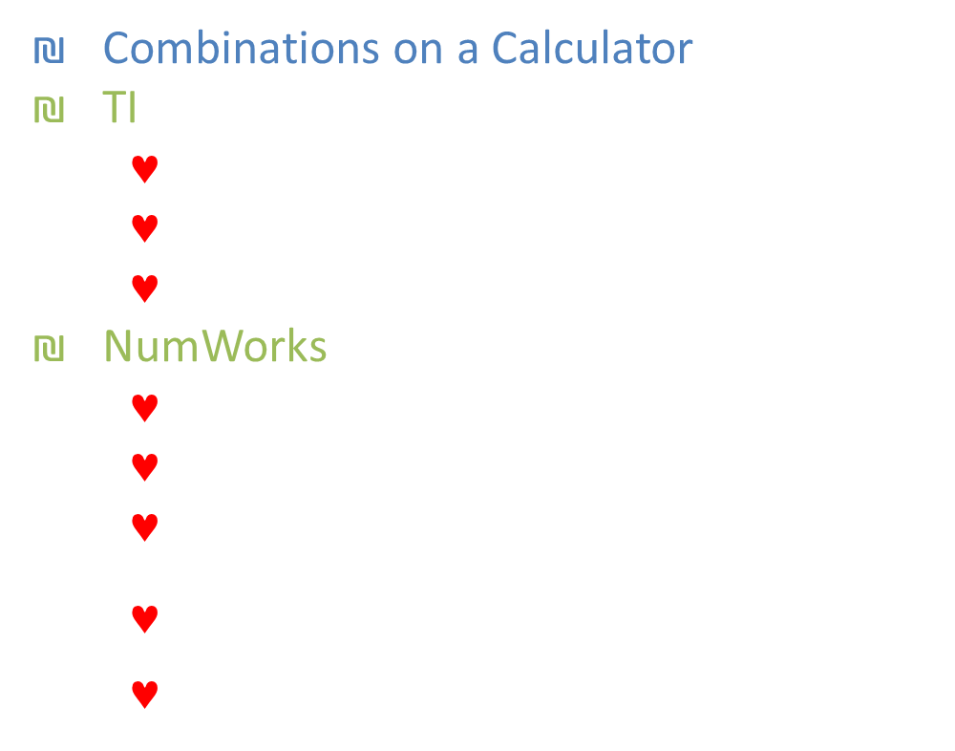
8.6A Permutations and Combinations
Combinations on a Calculator
TI
  Enter value of n
  Press MATH → PRB $↓$ nCr
  Enter value of r
NumWorks
  Press Toolbox button
  Down to Probability
  Down to Combinatorics
  $\left(\begin{matrix}n \\ k\end{matrix}\right)$
  Enter n then r
445#21
Evaluate ₅C₁
Try 445#23
Evaluate ₉C₉
Notes:
#21
$${{}_{5}^{}C}_{1}=5$$
#23
$${{}_{9}^{}C}_{9}=1$$

Slide 52
8.6A Permutations and Combinations
Count the possible combinations of 4 letters chosen from the list P, Q, R, S, T, U.
Try 445#17
A, B, C, D; r = 3
Notes:
$${{}_{6}^{}C}_{4}=15$$
#17
$${{}_{4}^{}C}_{3}=4$$

Slide 53
8.6A Permutations and Combinations
You are listening to music. You have time to listen to 3 songs from your playlist of 16 songs. How many combinations of 3 songs are possible?
Try 445#27
A team of 25 rowers attends a rowing tournament. Five rowers compete at a time. How many combinations of 5 rowers are possible?
Notes:
$${{}_{16}^{}C}_{3}=560$$
#27
$${{}_{25}^{}C}_{5}=53130$$

Slide 54
8.6A Permutations and Combinations
Tell whether to use a permutation or combination, then answer the question.
446#33
To complete an exam, you must answer 8 questions from a list of 10 questions. In how many ways can you complete the exam?
Try 446#35
Fifty-two athletes are competing in a bicycle race. In how many orders can the bicyclists finish first, second, and third?
Notes:
#33: Combination because no order
$${{}_{10}^{}C}_{8}=45$$
#35: Permutation because order
$${{}_{52}^{}P}_{3}=132600$$

Slide 55
8.6A Permutations and Combinations
An art teacher has selected 13 projects, including one of yours and one of your friend’s, to put into a display case in the hallway. The projects are placed at random. There is room for 2 projects in the middle row of the case. What is the probability that your project and your friend’s project are the 2 placed in the middle row?
Try 446#37
You and your friend are in the studio audience on a game show. From an audience of 300 people, 2 people are randomly selected as contestants. What is the probability that your and your friend are chosen?
445 #1, 3, 5, 7, 9, 13, 14, 15, 16, 17, 19, 21, 23, 27, 28, 33, 34, 35, 37, 38
Notes:
$$P\left(2 middle\right)=\frac{{{}_{2}^{}C}_{2}}{{{}_{13}^{}C}_{2}}=\frac{1}{78}=0.013$$
#37
$$P\left(2 people\right)=\frac{{{}_{2}^{}C}_{2}}{{{}_{300}^{}C}_{2}}=\frac{1}{44850}$$

Slide 56
8.6B the Binomial Theorem
After this lesson…
• I can expand powers of binomials using the binomial theorem.
• I can find coefficients in a binomial expansion.

Slide 57

8.6B Combinations and the Binomial Theorem
Binomial Theorem
  ${\left(a+b\right)}^{n}={{}_{n}^{}C}_{0}a^{n−0}b^{0}+{{}_{n}^{}C}_{1}a^{n−1}b^{1}+⋯+{{}_{n}^{}C}_{r}a^{n−r}b^{r}$
$$=\sum_{r=0}^{n}{{{}_{n}^{}C}_{r}a^{n−r}b^{r}}$$

Slide 58

8.6B Combinations and the Binomial Theorem
446#48
Expand ${\left(c−4\right)}^{5}$
Notes:
$${{}_{5}^{}C}_{0}c^{5}{\left(−4\right)}^{0}+{{}_{5}^{}C}_{1}c^{4}{(−4)}^{1}+{{}_{5}^{}C}_{2}c^{3}{\left(−4\right)}^{2}+{{}_{5}^{}C}_{3}c^{2}{\left(−4\right)}^{3}+{{}_{5}^{}C}_{4}c^{1}{\left(−4\right)}^{4}+{{}_{5}^{}C}_{5}c^{0}{\left(−4\right)}^{5}$$
$$1c^{5}1+5c^{4}(−4)+10c^{3}16+10c^{2}(−64)+5c^{1}256+1·1·\left(−1024\right)$$
$$c^{5}−20c^{4}+160c^{3}−640c^{2}+1280c−1024$$

Slide 59

8.6B Combinations and the Binomial Theorem
446#51
Expand ${\left(w^{3}−3\right)}^{4}$
Try 446#47
Expand ${\left(x+2\right)}^{3}$
Notes:
$${{}_{4}^{}C}_{0}{\left(w^{3}\right)}^{4}{\left(−3\right)}^{0}+{{}_{4}^{}C}_{1}{\left(w^{3}\right)}^{3}{\left(−3\right)}^{1}+{{}_{4}^{}C}_{2}{\left(w^{3}\right)}^{2}{\left(−3\right)}^{2}+{{}_{4}^{}C}_{3}{\left(w^{3}\right)}^{1}{\left(−3\right)}^{3}+{{}_{4}^{}C}_{4}{\left(w^{3}\right)}^{0}{\left(−3\right)}^{4}$$
$$1·w^{12}·1+4·w^{9}\left(−3\right)+6·w^{6}\left(9\right)+4·w^{3}\left(−27\right)+1·1\left(81\right)$$
$$w^{12}−12w^{9}+54w^{6}−108w^{3}+81$$
#47
$${{}_{3}^{}C}_{0}x^{3}2^{0}+{{}_{3}^{}C}_{1}x^{2}2^{1}+{{}_{3}^{}C}_{2}x^{1}2^{2}+{{}_{3}^{}C}_{3}x^{0}2^{3}$$
$$1x^{3}1+3x^{2}2+3x4+1·1·8$$
$$x^{3}+6x^{2}+12x+8$$

Slide 60


8.6B Combinations and the Binomial Theorem
446#56
Find the coefficient of the $x^{4}$ term in
  ${\left(x−3\right)}^{7}$
Try 446#55
Find the coefficient of the $x^{5}$ term in
${\left(x−2\right)}^{10}$
445 #47, 48, 49, 51, 53, 55, 56, 57, 58, 59, 67, 71, 83, 85, 87
Notes:
#56
$$n=7, n−r=4→7−r=4→r=3$$
$${{}_{7}^{}C}_{3}a^{7−3}b^{3}=35·{\left(x\right)}^{4}{\left(−3\right)}^{3} →−945x^{4}$$
#55
$$n=10, n−r=5→10−r=5→r=5$$
$${{}_{10}^{}C}_{5}a^{10−5}b^{5}=252·x^{5}·{\left(−2\right)}^{5}=−8064x^{5}$$

Slide 61
8.7 Binomial Distributions
After this lesson…
• I can explain the meaning of a probability distribution.
• I can construct and interpret probability distributions.
• I can find probabilities using binomial distributions.

Slide 62
8.7 Binomial Distributions
Probability Distribution
  Function that gives the probability of each of the possible outcomes in a probability experiment
  The sum of the probabilities = 1
Construct a Probability Distribution
  Make a table of probabilities
  Make a histogram

Slide 63
8.7 Binomial Distributions
The spinner is divided into three equal parts. Let x be a random variable that represents the sum when the spinner is spun twice. Make a table and draw a histogram showing the probability distribution for x.
Try 453#1
Notes:
Sample Space
(0, 0) (1, 0) (2, 0)
(0, 1) (1, 1) (2, 1)
(0, 2) (1, 2) (2, 2)
Table
x 0 1 2 3 4
P(x) $\frac{1}{9} \frac{2}{9} \frac{3}{9} \frac{2}{9} \frac{1}{9}$
Make histogram
#1: Sample Space: 1, 1, 1, 1, 1, 2, 2, 2, 3, 3
Table
X 1 2 3
P(x) 0.5 0.3 0.2

Slide 64
8.7 Binomial Distributions
Use the probability distribution in the previous slide to answer each question.
What is the most likely sum when spinning the three-section spinner twice?
What is the probability that the sum of the two spins is odd?
Try 453#5
Notes:
2
$\frac{2}{9}+\frac{2}{9}=\frac{4}{9}=0.444$
#5a: 2 most likely; b: 5/8

Slide 65

8.7 Binomial Distributions
Binomial Distributions
  Two outcomes: Success or failure
  Independent trials (n)
  Probability for success is the same for each trial (p)
$P\left(k successes\right)={{}_{n}^{}C}_{k}p^{k}{\left(1−p\right)}^{n−k}$

Slide 66
8.7 Binomial Distributions
Calculate the probability of flipping a coin 20 times and getting 3 heads.
Try 453#7
only 1 head
Notes:
$$P\left(3\right)={{}_{20}^{}C}_{3}{(0.5)}^{3}{\left(1−0.5\right)}^{20−3}=0.00109$$
#7
$$P\left(1\right)={{}_{20}^{}C}_{1}{\left(0.5\right)}^{1}{\left(1−0.5\right)}^{20−1}=0.0000191$$

Slide 67
8.7 Binomial Distributions
At college, 53% of students receive financial aid. In a random group of 9 students, what is the probability that exactly 5 of them receive financial aid?
Notes:
$$p=.53, n=9, k=5$$
$$P\left(5\right)={{}_{9}^{}C}_{5}{\left(0.53\right)}^{5}{\left(1−.53\right)}^{9−5}=0.257$$

Slide 68
8.7 Binomial Distributions
Draw a histogram of binomial distribution of students in example 1 and find the probability of fewer than 3 students receiving financial aid.
Notes:
Make a table in the calculator by entering
$$y={{}_{9}^{}C}_{x}·{0.53}^{x}·{\left(1−0.53\right)}^{9−x}$$
$$P\left(0\right)={{}_{9}^{}C}_{0}{\left(0.53\right)}^{0}{\left(1−0.53\right)}^{9−0}=0.00112$$
$$P\left(1\right)={{}_{9}^{}C}_{1}{\left(0.53\right)}^{1}{\left(1−0.53\right)}^{9−1}=0.01136$$
$$P(2) = .05123$$
$$P(3) = .13480$$
$$P(4) = .22801$$
$$P(5) = .25712$$
$$P(6) = .19330$$
$$P(7) = .09342$$
$$P(8) = .02634$$
$$P(9) = .00330$$
$$P(<3) = P(0) + P(1) + P(2) = .00112 + .01136 + .05123 = .06371$$

Slide 69
8.7 Binomial Distributions
Try 453#11
In your school, 30% of students plan to attend a movie night. You ask 5 randomly chosen students from your school whether they plan to attend the movie night.
a. Draw a histogram
b. Most likely
c. Probability at most 2 attend
      453 #1, 3, 5, 7, 9, 11, 12, 13, 15, 17, 19, 21, 23, 25, 27
Notes:
a. Make a table in the calculator by entering
$$y={{}_{5}^{}C}_{x}·{0.3}^{x}·{\left(1−0.3\right)}^{5−x}$$
$$P\left(0\right)={{}_{5}^{}C}_{0}{\left(0.3\right)}^{0}{\left(1−0.3\right)}^{5−0}=0.16807$$
$$P\left(1\right)={{}_{5}^{}C}_{1}{\left(0.3\right)}^{1}{\left(1−0.3\right)}^{5−1}=0.36015$$
$$P(2) =0.3087$$
$$P(3) =0.1323$$
$$P(4) =0.02835$$
$$P(5) =0.00243$$
b. 1 is most likely
c. $P\left(at most 2\right)= P\left(0\right)+ P\left(1\right)+ P\left(2\right)=0.16807 +0.36015 +0.3087 =0.83692$

